Slide 1
Direct Methods

Slide 2
Direct Methods
Direct method search using function evaluations only
Also called zero-order, black box, pattern search, or derivative-free methods

Slide 3
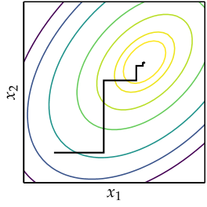



Cyclic Coordinate Search
Also known as coordinate descent, or taxicab search
Performs line search in alternating coordinate directions

Slide 4
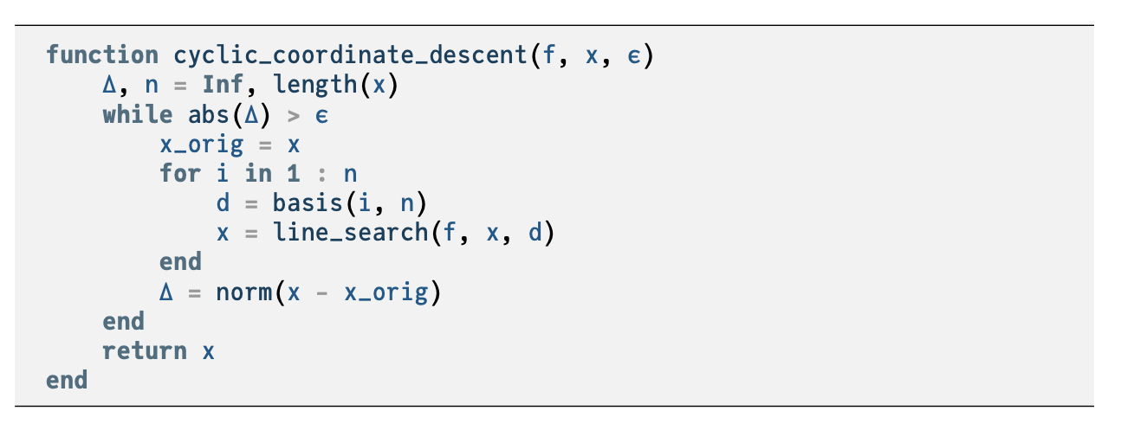











Slide 5
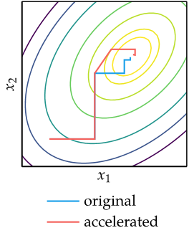






Cyclic Coordinate Search
Can be augmented to accelerate convergence

Slide 6
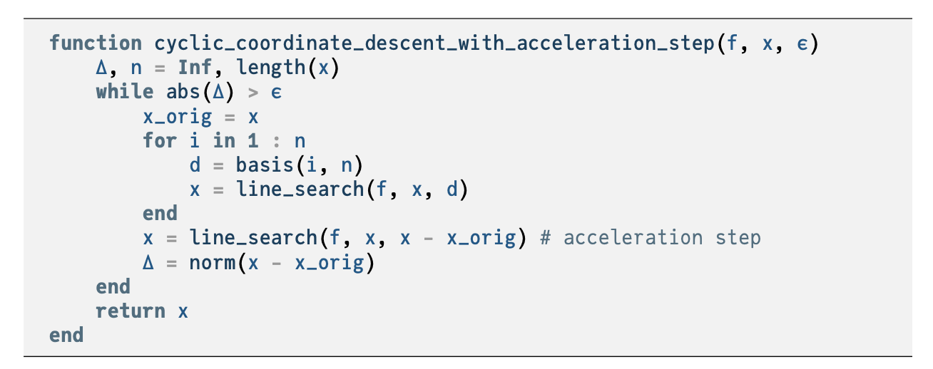





Slide 7
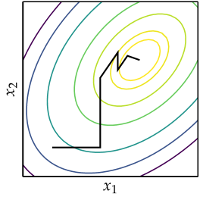





Powell’s Method
Similar to Cyclic Coordinate Search, but can search in non-orthogonal directions

Slide 8
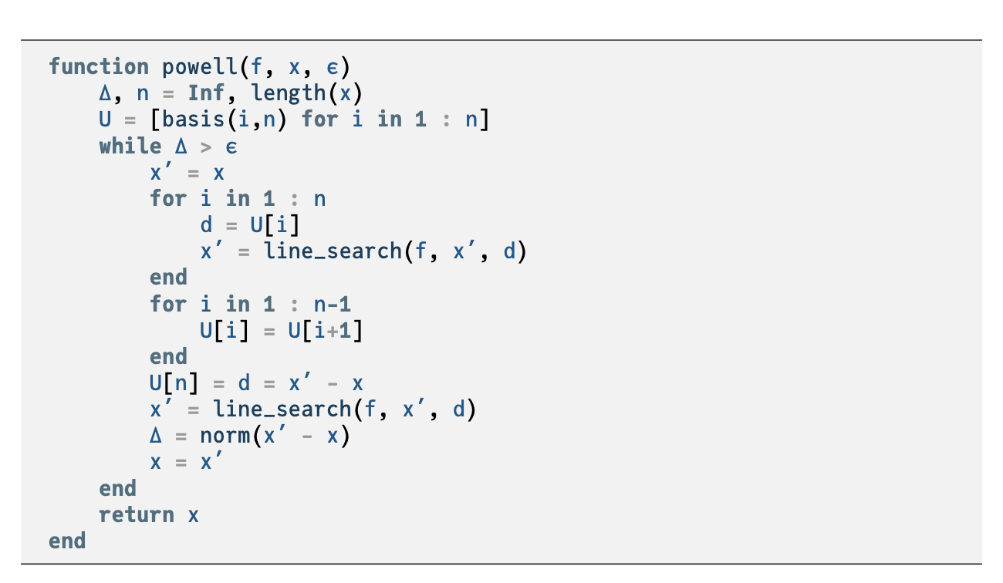












Slide 9
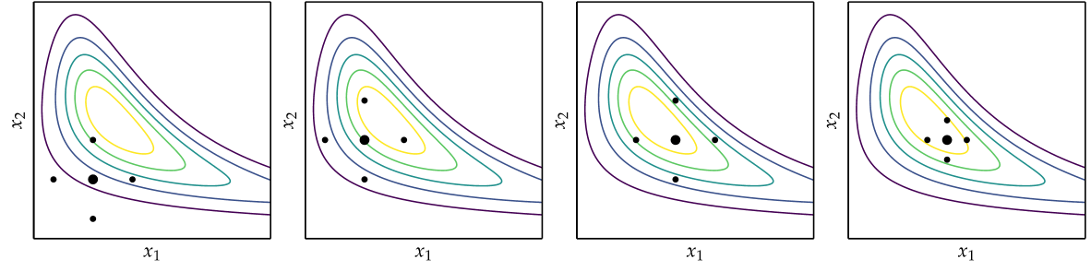




Hooke-Jeeves

Slide 10
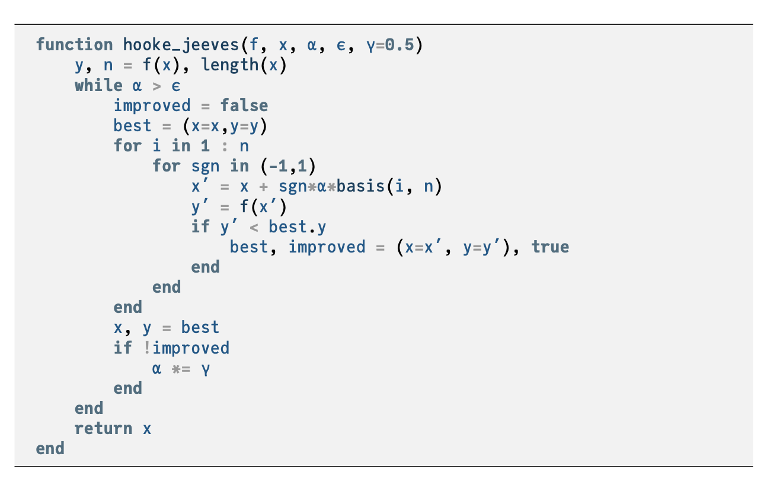



Slide 11
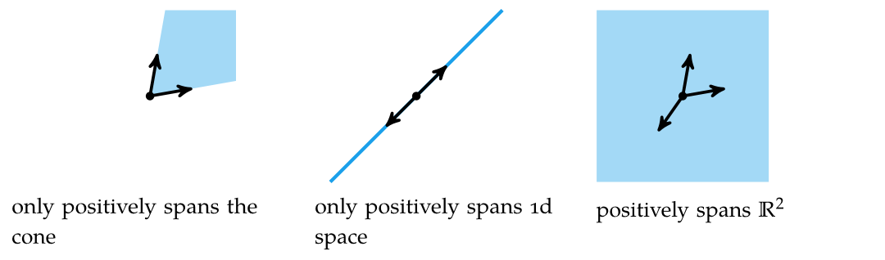
Generalized Pattern Search
Generalization of Hooke-Jeeves method
Searches in set of directions that positively spans search space

Slide 12
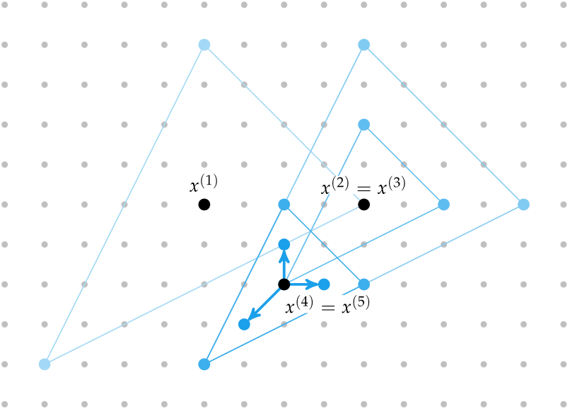










Generalized Pattern Search

Slide 13
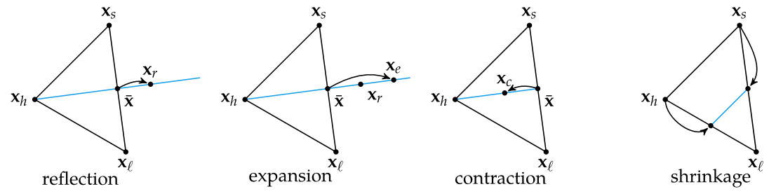












Nelder-Mead Simplex Method
Uses simple algorithm to traverse search space using set of points defining a simplex

Slide 14
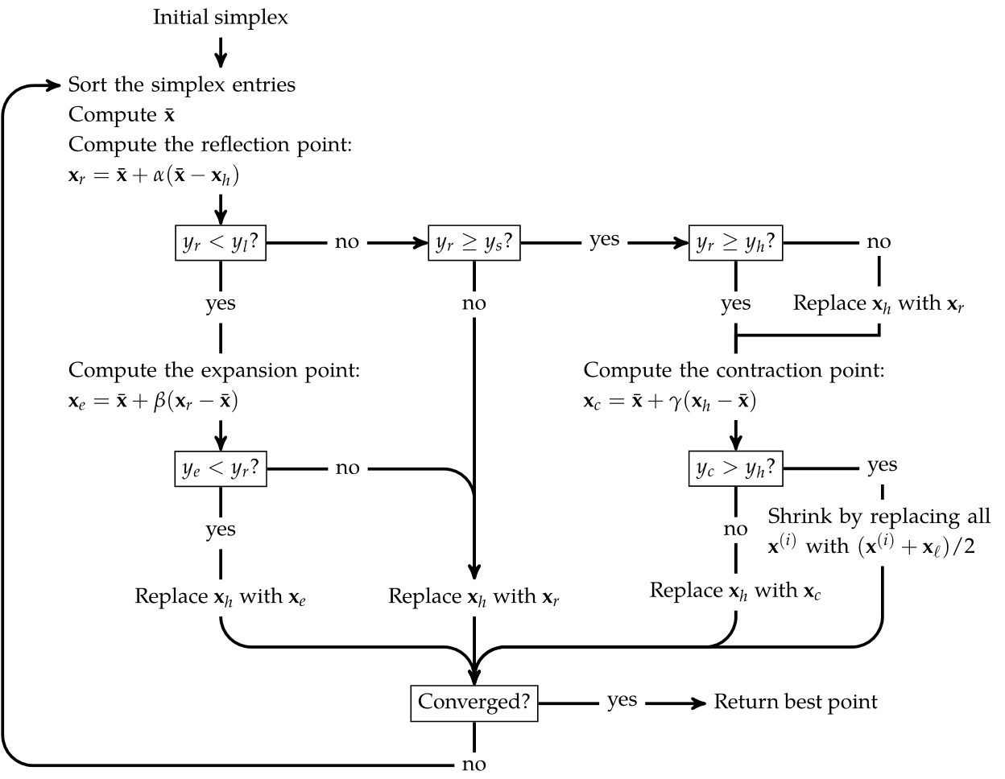




Nelder-Mead Simplex Method

Slide 15
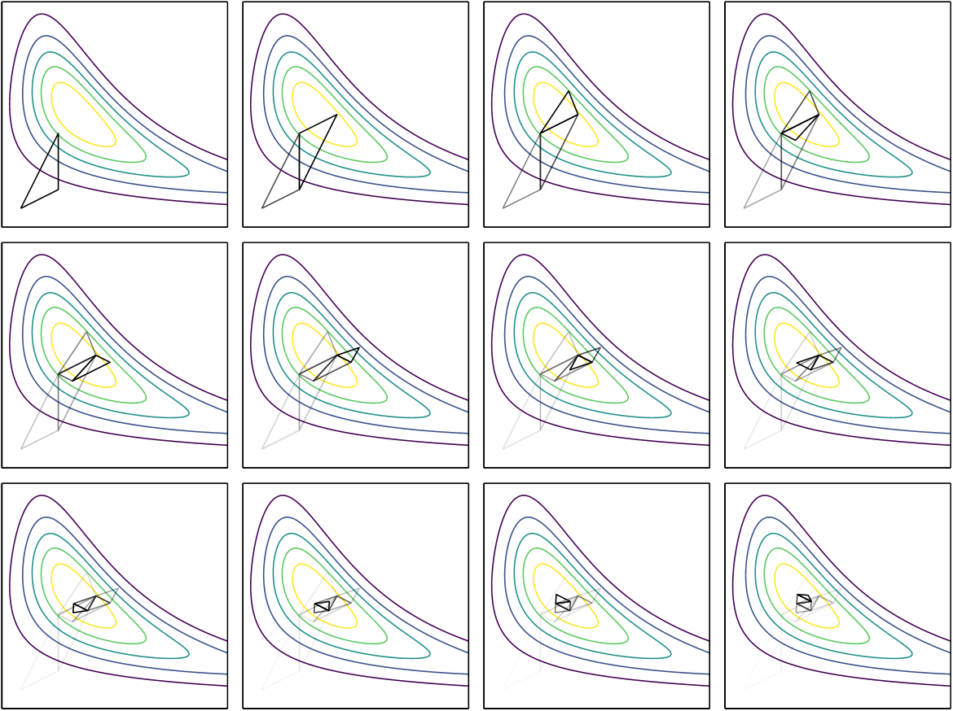
Nelder-Mead Simplex Method

Slide 16
Summary
Direct methods rely solely on the objective function and do not use derivative information.
Cyclic coordinate search optimizes one coordinate direction at a time.
Powell’s method adapts the set of search directions based on the direction of progress.
Hooke-Jeeves searches in each coordinate direction from the current point using a step size that is adapted over time.

Slide 17
Summary
Generalized pattern search is similar to Hooke-Jeeves, but it uses fewer search directions that positively span the design space.
The Nelder-Mead simplex method uses a simplex to search the design space, adaptively expanding and contracting the size of the simplex in response to evaluations of the objective function.
The divided rectangles algorithm extends the Shubert-Piyavskii approach to multiple dimensions and does not require specifying a valid Lipschitz constant.

